Slide 1
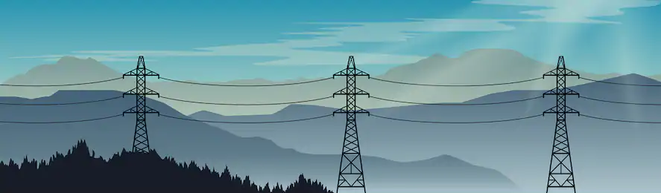

Pitch Deck
Forecasting Regional Electrical Loading Using Machine Learning Algorithms

Slide 2

Problem
Difficulty estimating short-term energy demand
Inaccurate forecasts creates a surplus in electrical generation
Additional fees for Independent Electricity System Operators and downstream customers

Slide 3

Solution
Use Machine Learning to use a matrix of inputs from real historical data
to learn trends
Effective hourly climate data specific to each region to better
forecast customer load
Data is collected accurately and reliably from government
databases

Slide 4
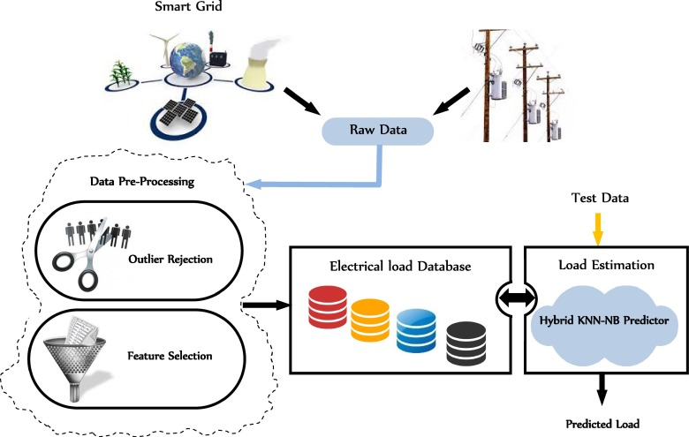
Our Product

Slide 5
Login

Slide 6
User Interface

Slide 7
Model

Slide 8
Forecast

Slide 9
Samples

Slide 10




Business Model
Value Proposition
Customers, Partners, Stakeholders
Consistent accurate forecasts of regional electric load
Minimize loss when selling a surplus of electricity, thus increasing their net income.
Comprises of two sources of revenue:
Subscription based service
Purchase the forecasting model outright
Primary cost incurred will be from the result of data storage relevant to the model
Secondary costs will comprise of Microsoft Azure Subscriptions
Revenue Streams
Cost Model

Slide 11
Financials

Slide 12



Our Team
Adam
Dunn
23
Bachelor’s of Electrical Engineering
Dheeraj
Ghangas
23
Honour’s Bachelor of Business Administration
Nathen
Gay
23
Honour’s Bachelor of Technology – Software Development

Slide 13
Next Steps

